Slide 1
CHEM-E5140 Materials Characterization Laboratory Course
10.03.2025
Girish Tewari
girish.tewari@aalto.fi
B202, Kemistintie 1

Slide 2
Outline
Introduction
Light / Particle and material interaction
Electronic Transport in Materials
Techniques used
Next week topic

Slide 3
Introduction
Consists of atoms
Atoms can be same or different types
Matter
Periodic/Random arrangements
Phase (solid/liquid/gas)
Powders/Thin Films/Nanostructures
Material Characterization: To probe physical/chemical (structure, composition) properties of materials (microscopic and nanoscopic domains)
Structural Analysis (Crystal Structure, Lattice Parameters etc)
Elemental Analysis (Constituents atoms and their weightage)
Surface Analysis (Surface morphology/roughness, mechanical properties)
Size Analysis (Nanostructure sizes)
Electronic Properties (metal/semiconductor/insulator, type of semiconductor)

Slide 4
Light / Particle and material interaction
Spectroscopy
Microscopy
Spectroscopy is the study of interaction of electromagnetic radiation with matter. Spectroscopic methods can be based on phenomena of transmission, absorption, fluorescence or scattering.
Electron or optical microscopy is used to analyse objects which can not be seen by naked eyes
They involve the diffraction, reflection, or refraction of electromagnetic radiation/electron beams interacting with the matter
Dispersion of white light
Incident beam
X-ray
vibrations
Incident beam
Scattering
electrons
Light
Absorption
sample
Sample
Transmission

Slide 5
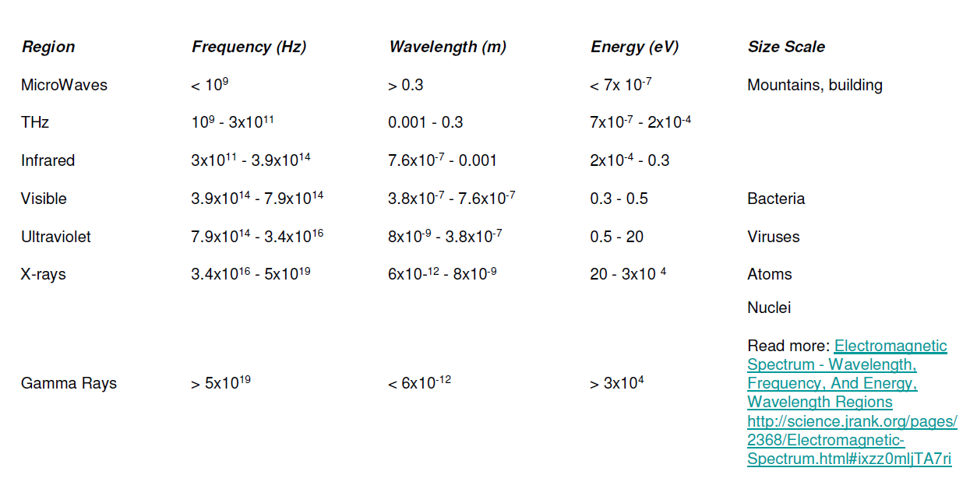
Electromagnetic Radiation Spectrum

Slide 6
Techniques Used
Electronic properties (Electronic Transport (ET))
Elemental composition (surface):EDS, XPS, XRF
SIMS
Auger
SEM
Raman
XRD
AFM
Material physical and chemical properties,
Resistivity and Hall measurement in semiconductors
EDS
Topography, mechanical properties surfaces :
SEM, STM, AFM, Nanoindentation
Bulk structure : XRD

Slide 7
Next Week Topic/Pretask
Due on NEXT Monday 16.3 before 20:00 pre-assignment.
Make it clear to yourself!
Bring your pre-assignment and the image you have drawn…
X-ray Diffraction (XRD)
+ Book the time for the laboratory!

Slide 8

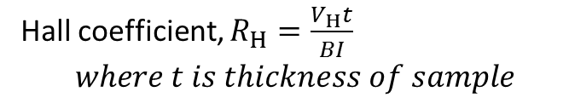


Resistivity and Hall effect measurement in semiconductor
How easy to drive a current through a material
Resistivity
Hall measurement
$$ρ=\frac{RA}{L}$$
Hall coefficient, $R_{H}=\frac{V_{H}t}{BI}$
$$where t is thickness of sample$$
R$=\frac{V}{I}$
$$L$$
V(V)
B, magnetic field
I(A)
I(A)
I(A)
I(A)
V_{H}(V)
You need sample size (Length, width and thickness) to get the parameters (Resistvity and Hall coefficient)

